Slide 1
MINING THE ENIGMA DATASET
Adithya
Deepak
Pit
Ritu

Slide 2
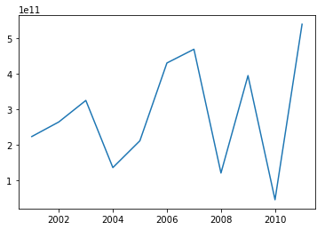
Government Spending Stagnates During Election Years
Amount committed by government per year (dollars)
Time (Years)

Slide 3
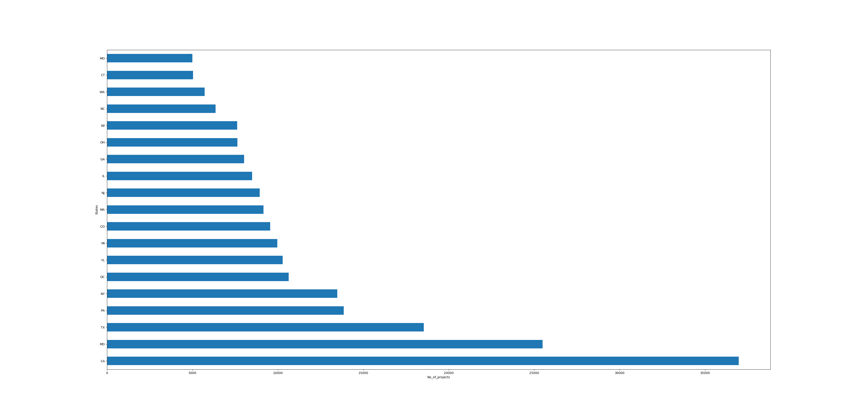
Government expenditure in different states

Slide 4
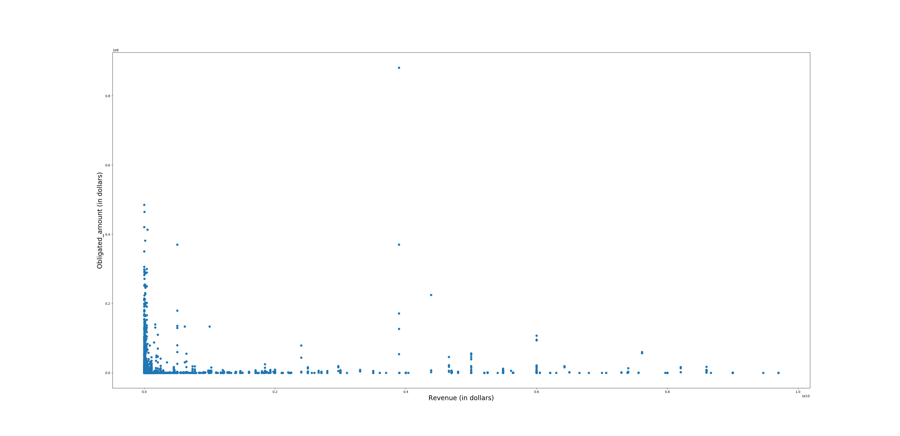
Companies with lower revenues tend to receive bigger projects

Slide 5
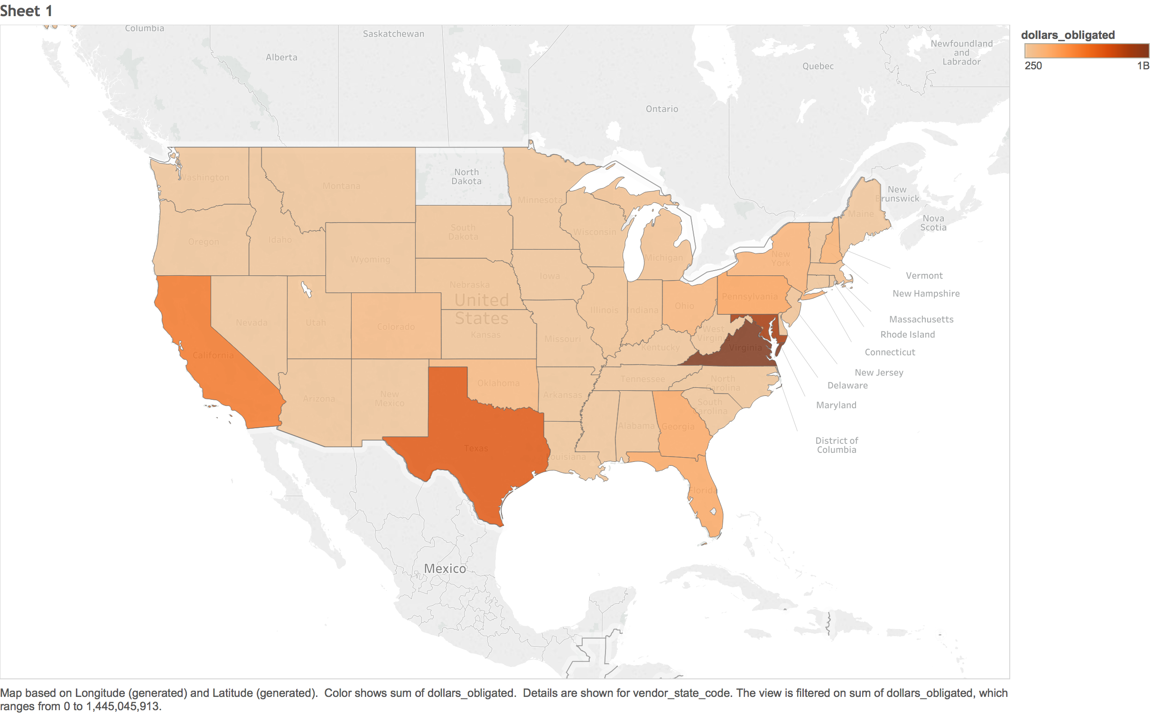

Slide 6
